Slide 1
Angular
Pipes

Slide 2
Agenda
Introduction
Built-int Pipes
Async Pipe
Custom Pipes

Slide 3
Pipes
1
Introduction

Slide 5
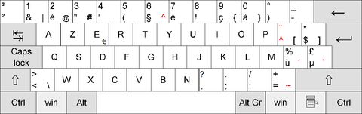

Slide 6
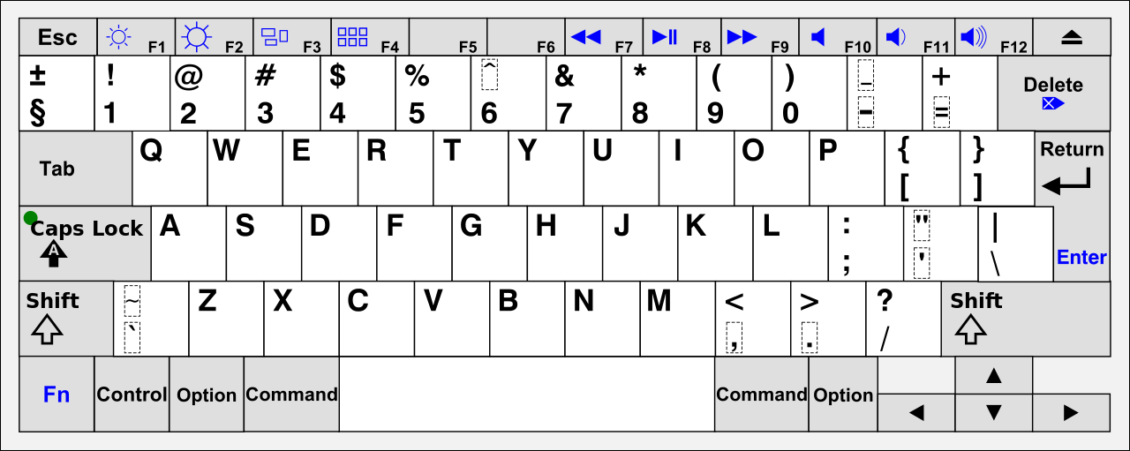

Slide 7
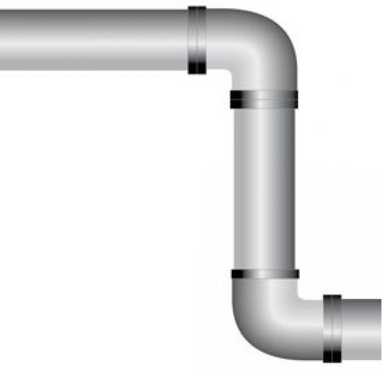
INPUT
OUTPUT

Slide 8
Pipes
Pipes are used to format data
Pipes get their input from:
Variables
Expressions
Values returned by functions
Can format data of various types
String
Number
Date
Array

Slide 9
Pipes
Pipes can be used
In HTML templates
In JavaScript
Pipes can be chained
In angular 1 they where called filters
Most of the filters are converted from Angular 1 to Angular 2

Slide 10
Built-in Pipes
@Component({
selector: 'demo',
template: `<h1>{{ name | uppercase}}</h1>`
})
export class DemoComponent {
name: string = "kevin";
}

Slide 11
Built-in Pipes
uppercase
lowercase
date
currency
percent
https://angular.io/api?type=pipe

Slide 12
Chaining Pipes
Make a combination of pipes
@Component({
selector: 'demo',
template: `
<h1>{{ name | uppercase}}</h1>
<h2>{{birthday | date: 'MMMM dd, yyyy'| uppercase}}</h2>
`
})

Slide 13
Pipes and change detection
Angular looks for changes through a change-detection process that runs after every DOM event
Could be expensive
Angular picks a simpler, faster change detection algorithm when you use a pipe
https://angular.io/guide/pipes

Slide 14
Pipes
2
Async pipe

Slide 15
AsyncPipe
Accepts a Promise or Observable as input and subscribes to the input
AsyncPipe is stateful
Maintains a subscription to the input Observable and keeps delivering values from that Observable

Slide 16
Pipes
3
Custom pipes

Slide 17
Custom Pipes
Import the Angular Pipe class
Export the class
Add the @Pipe annotation and name your pipe
Implement method named “transform”
import { Pipe } from "@angular/core";
@Pipe({ name: "stringLength" })
export class StringLengthPipe {
transform(value: string, length: number) {
return value.substring(0, length);
}
}

Slide 18
Custom Pipes
Each custom pipe
Has the @pipe decorator
Implements the PipeTransform interface
The transform method is essential.
The interface is optional, angular looks for the transform method

